Slide 1

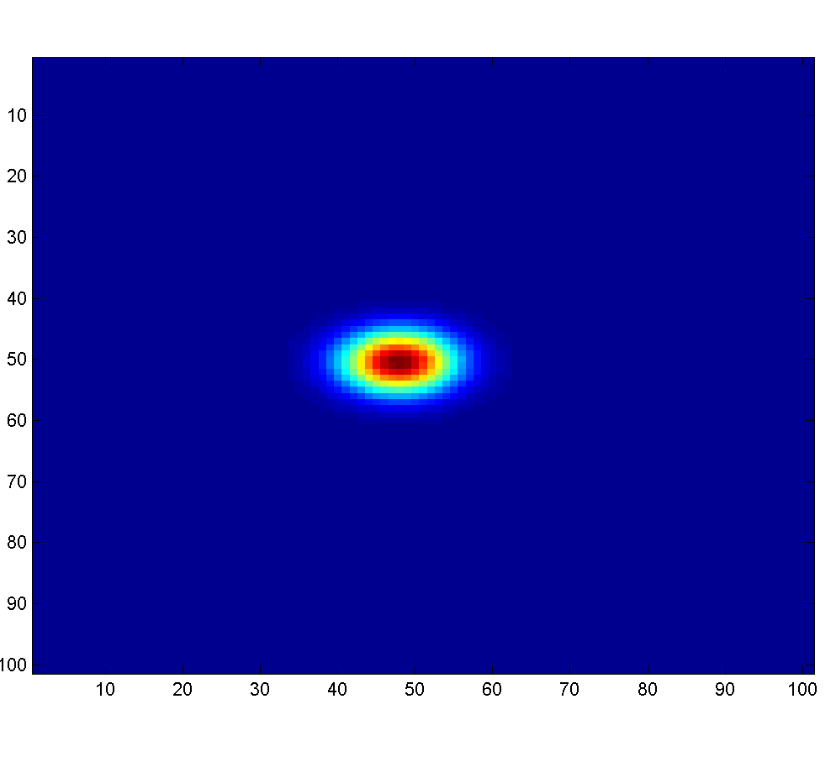
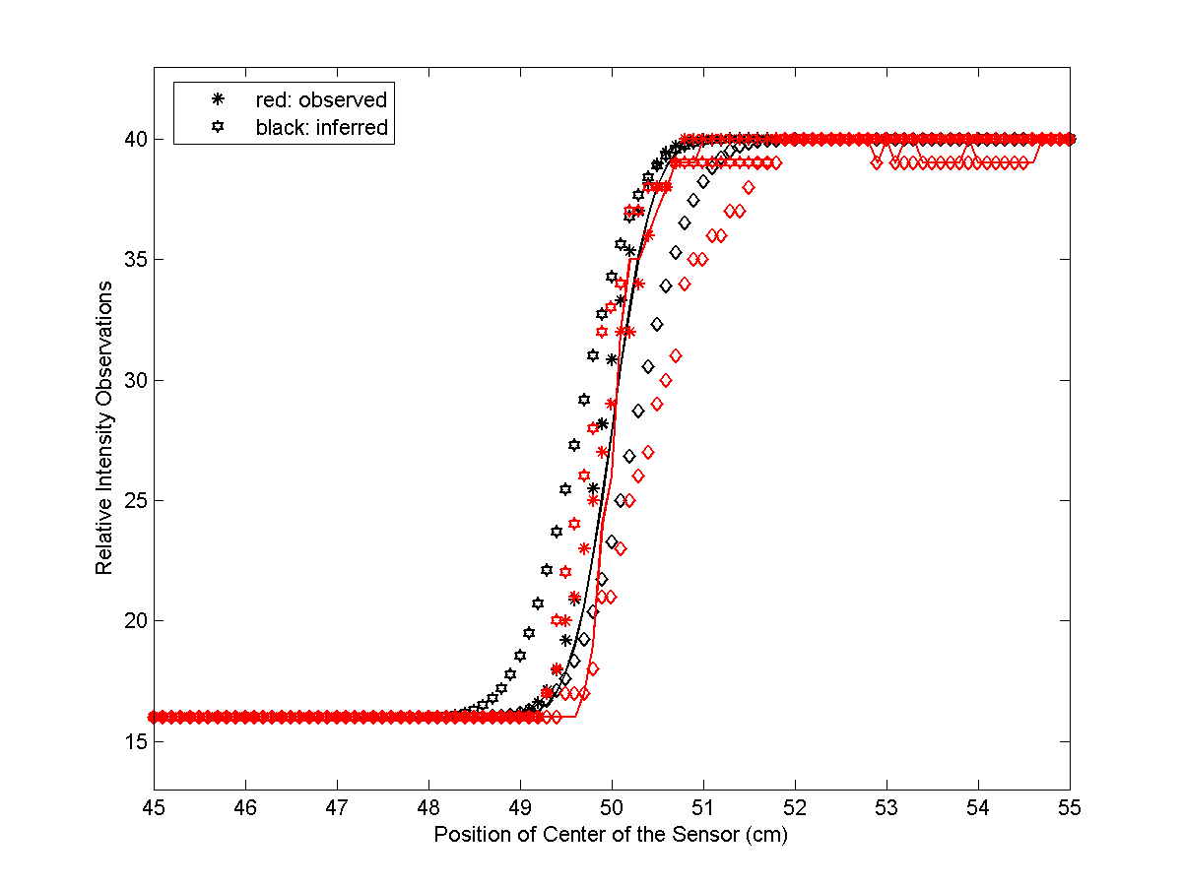
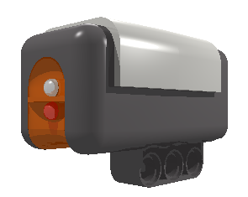
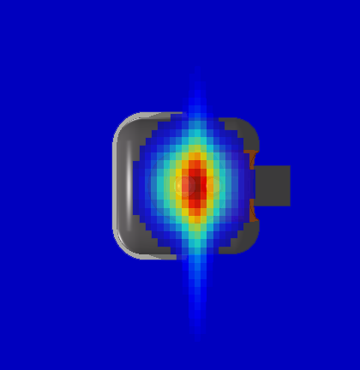
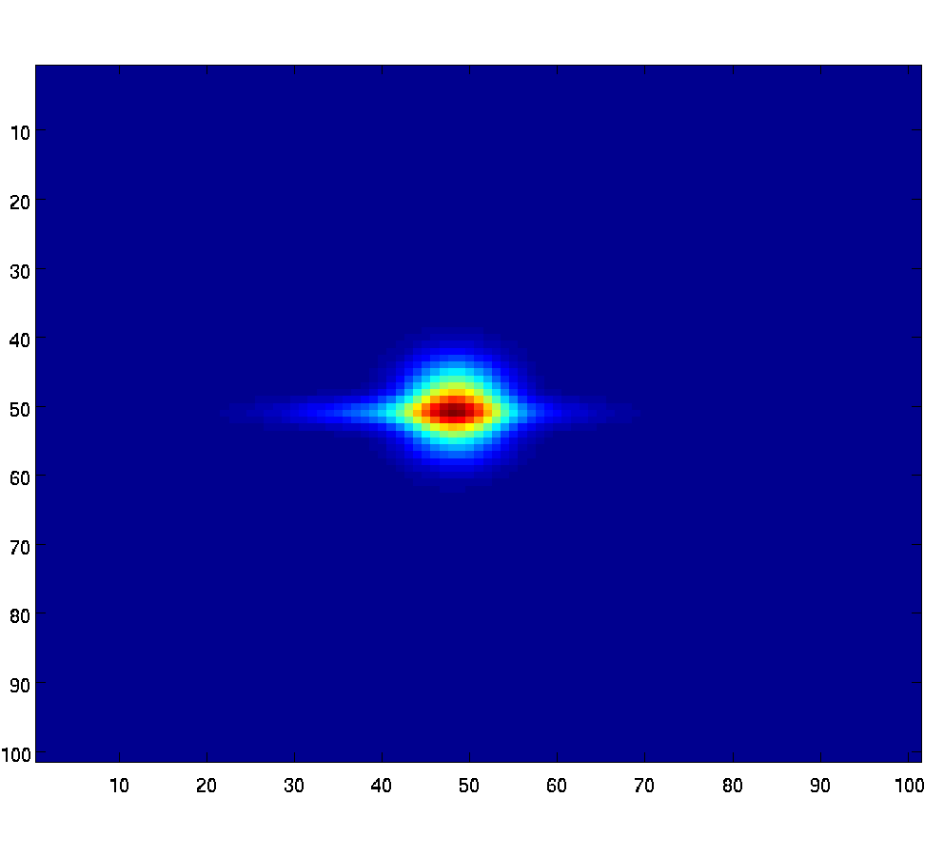
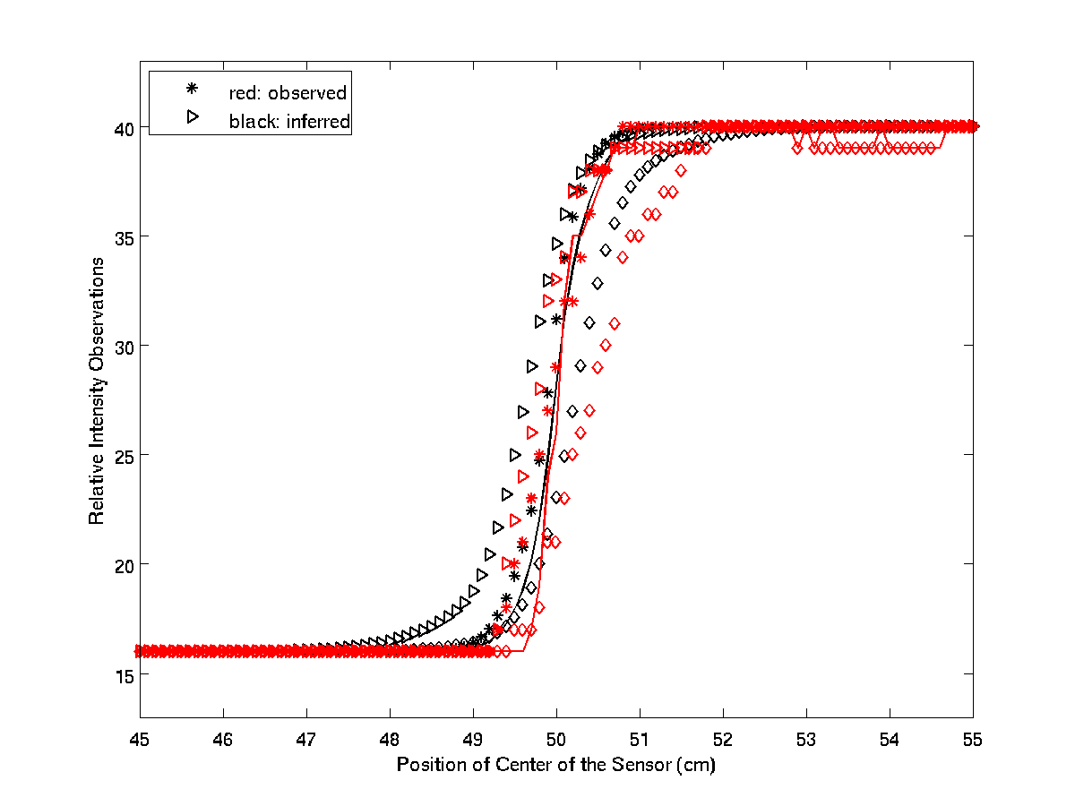
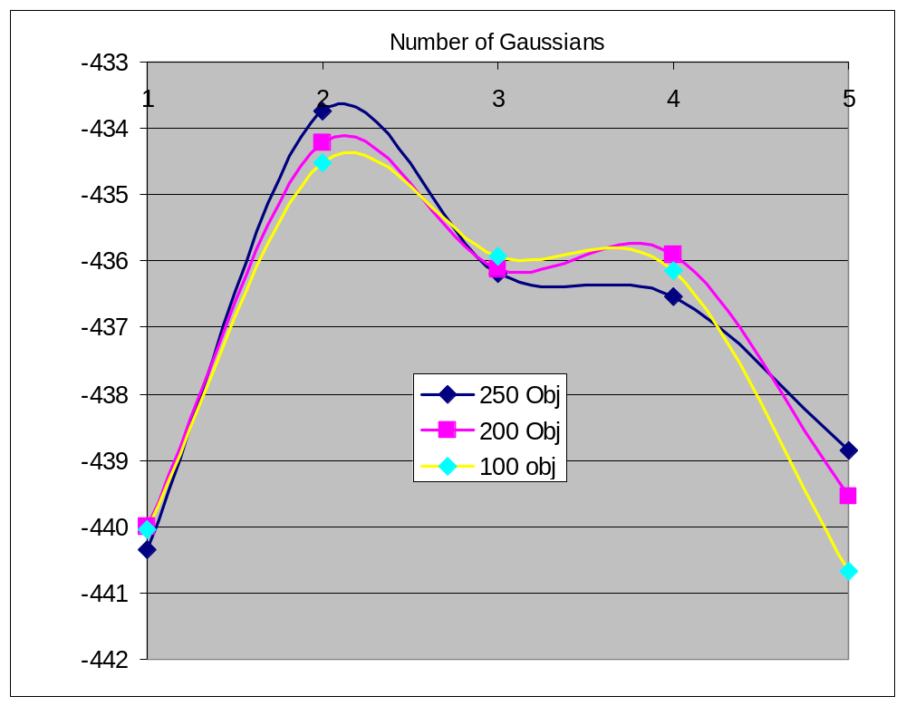
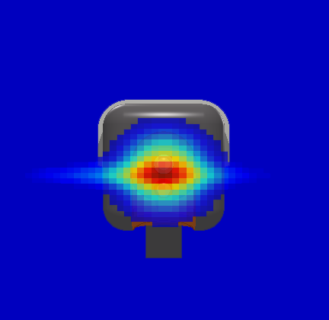
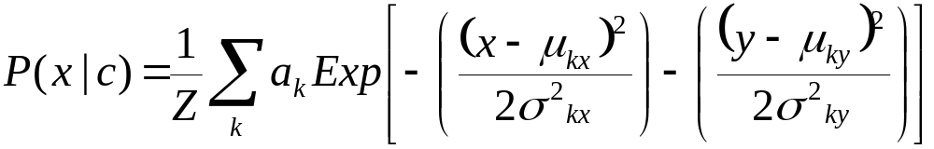
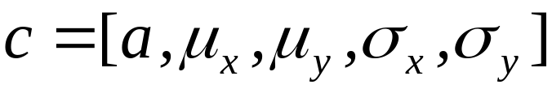

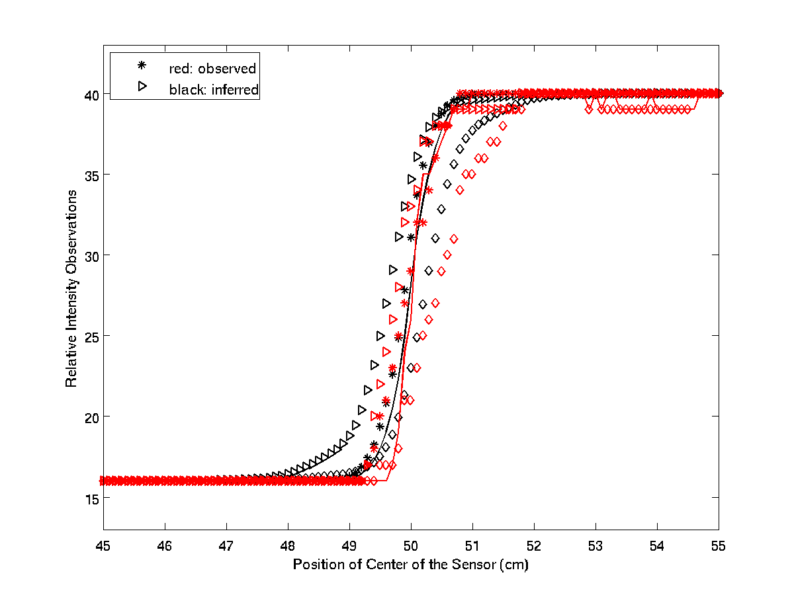
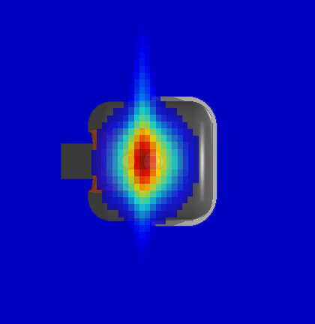
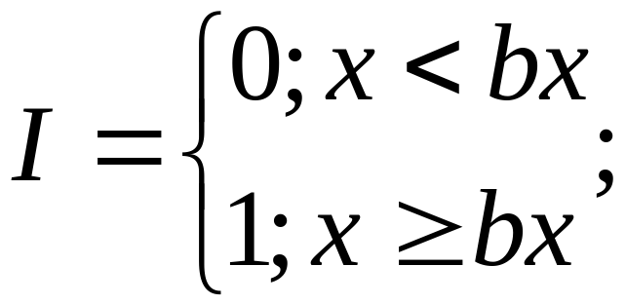
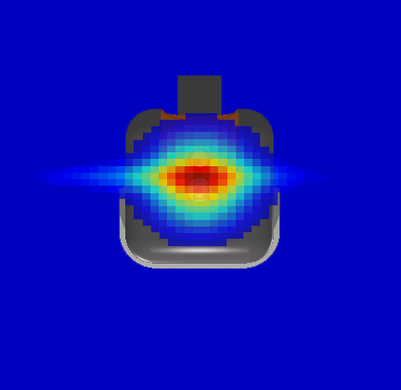
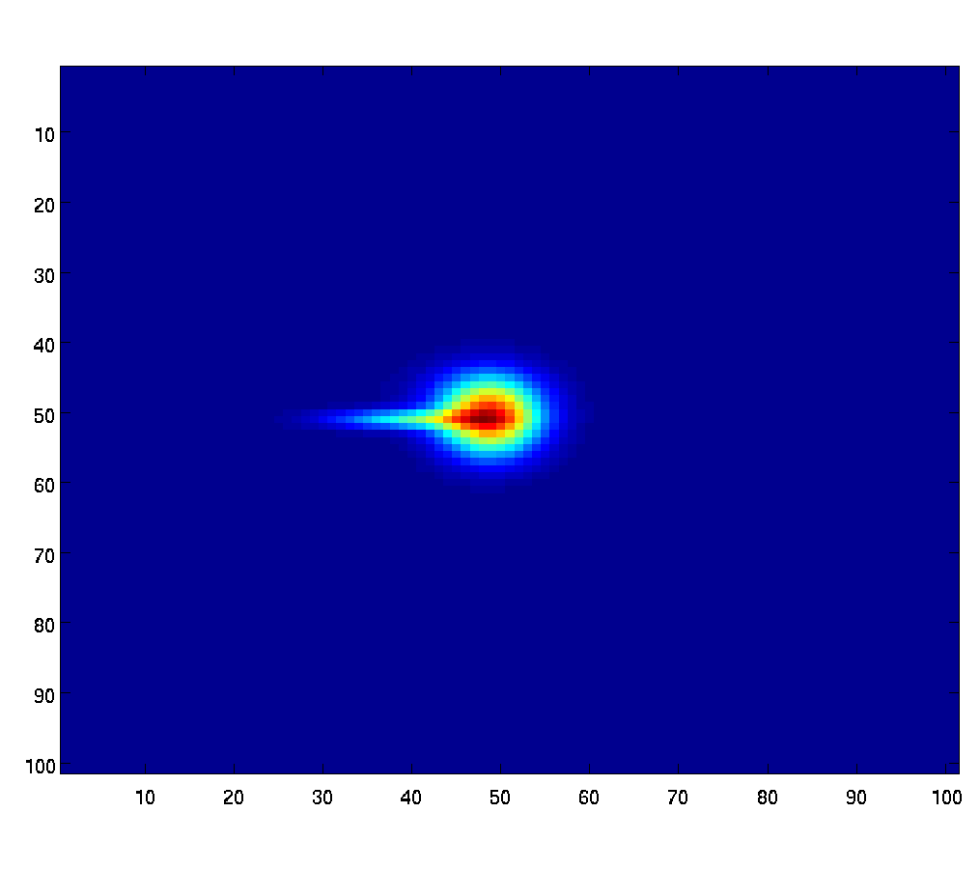

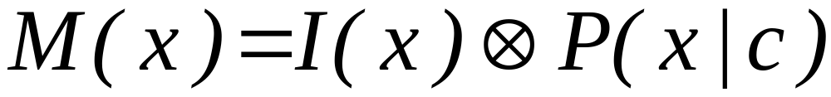
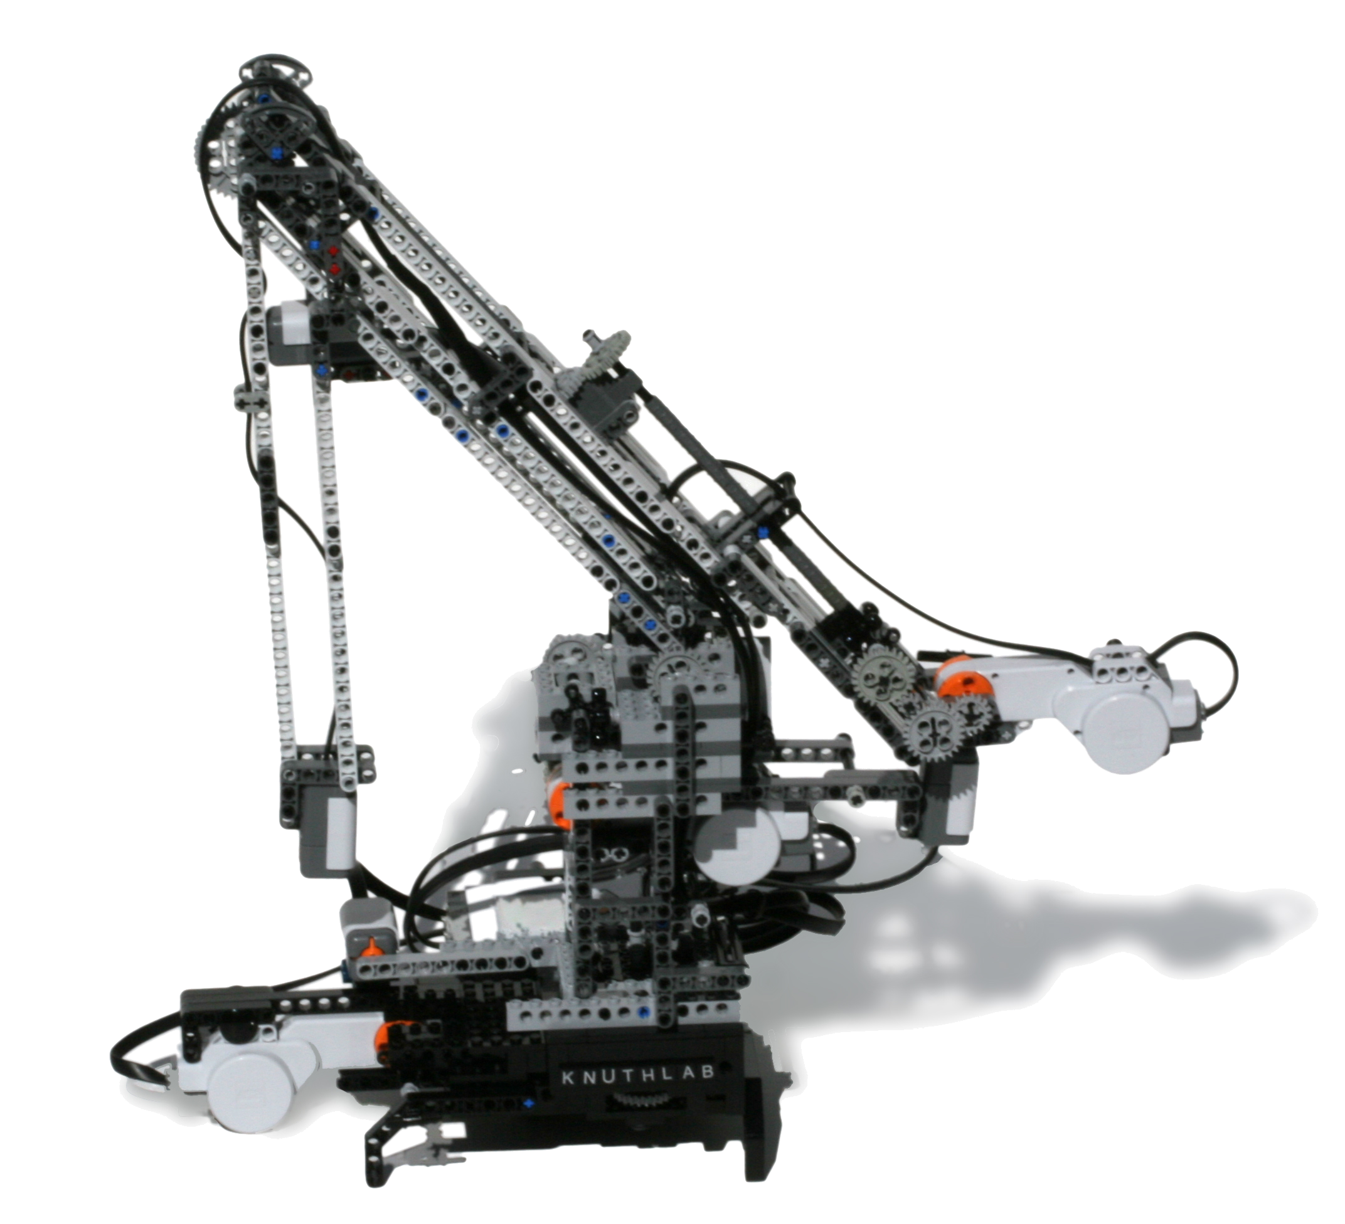
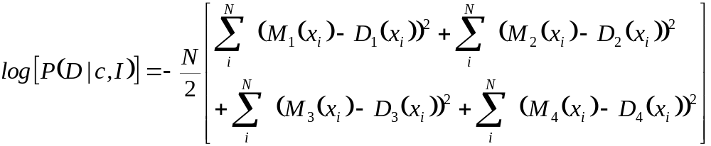
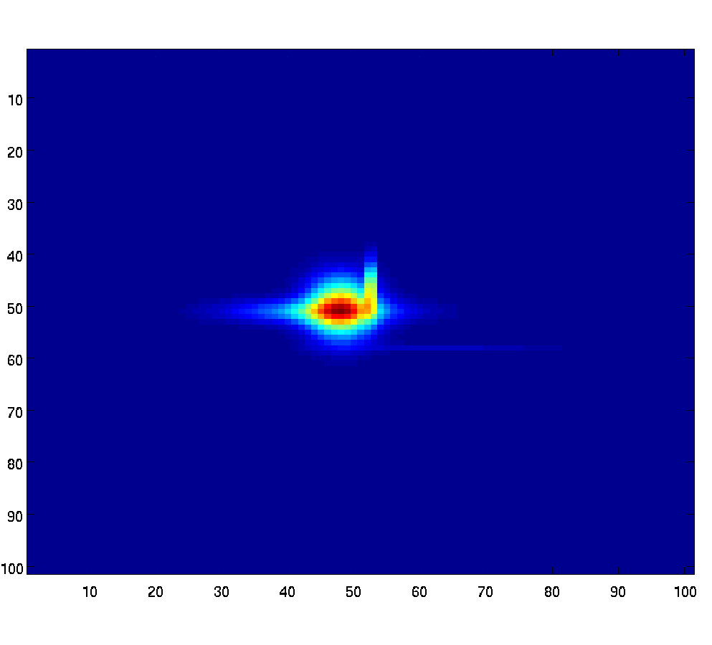

Estimating the Spatial Sensitivity Function of A Light Sensor
N. K. Malakar, A. J. Mesiti and K. H. Knuth
University at Albany, State University of New York, Albany, NY
Introduction
SSF: Observations and Predictions
Results
This project focuses on estimating the Spatial Sensitivity Function (SSF) of a simple light intensity sensor. This light sensor has been used in the Knuth Cyberphysics Laboratory on a robotic arm that performs its own experiments to locate a white circle in a dark field (Knuth et al., 2007).
We model the light sensor’s response to a hypothetical stimulus by Mixture of Gaussians (MOG) to make predictions about the data.
We apply Bayesian inference to learn about the underlying components of MOG model and compare the evidence on the light of observation data.
The light sensor was swept across a black background followed by a white background. We rotated the sensor to get four sets of intensity data. Nested Sampling was used to infer the SSF.
Mixtures of Gaussians were tested with different number of objects in a Nested Sampling algorithm. The evidence was computed for each model.
Sensor Orientations
Model: MOG | Evidence (250 Objects) | Evidence (200 Objects) | Evidence (100 Objects) | Number of Parameters
Asymmetric 1G | -440.3561 | -440.0029 | -440.0399 | 4
Symmetric 1G | - | - | -477.7277 | 3
Asymmetric 2G | -433.7316 | -434.2040 | -434.5098 | 10
Symmetric 3G | - | - | -436.6882 | 12
Asymmetric 3G | -436.1786 | -436.1131 | -435.9219 | 15
Asymmetric 4G | -436.5303 | -435.9072 | -436.1423 | 20
Symmetric 4G | - | - | -441.2039 | 16
Asymmetric 5G | -438.8655 | -439.5407 | -440.6841 | 25
Asymmetric Gaussian: SSF and its predictions
The LEGO NXT sensor
Methods
A Mixture of Gaussians (MOG) is used to model the SSF.
Orientation#1
Asymmetric 2 MOG: SSF and its predictions
where denotes the parameters of the Gaussian.
Orientation#2
Intensity Function:
Future Work
where x is the position of the sensor and bx is the position of the boundary.
Orientation#3
Only one height has been considered at this time, future works will involve motion of the sensor in three dimensional space and computing SSF for each height
A Non-Parametric Grid model will also be considered for the SSF.
The SSF may be better characterized using more complex black and white patterns.
Asymmetric 3 MOG: SSF and its predictions
The sensor output is a convolution of the MOG model with the background intensity function:
With student-t as the likelihood and a flat prior,
the log Posterior for four sets of observations is :
Orientation#4
Asymmetric 4 MOG: SSF and its predictions
Acknowledgements
We used Nested Sampling (Skilling 2005) to infer the parameter values.
The work was supported partially by a University at Albany Benevolent Research Grant (Malakar) and a Faculty Research Award Program Grant (Knuth).
Asymmetric 5 MOG: SSF and its predictions

